Slide 1
How to Analyze the data
Vinay Mahajan
Varsha Mahajan
Testing of Hypothesis

Slide 2
Continuation from the last class … Use of Simple Regression
Answering Research Questions and Testing Hypothesis
Making Prediction about Some Outcome or Dependent Variable
Assessing an Instrument Reliability
Assessing an Instrument Validity

Slide 3
Types of variables to be analyzed
Statistical procedure
or measure of association
Predictor variable/s
Outcome variable
Cross-sectional/case-control studies
Binary (two groups)
Continuous
T-test
Binary
Ranks/ordinal
Wilcoxon rank-sum test
Categorical (>2 groups)
Continuous
ANOVA
Continuous
Continuous
Simple linear regression
Multivariate
(categorical and continuous)
Continuous
Multiple linear regression
Categorical
Categorical
Chi-square test (or Fisher’s exact)
Binary
Binary
Odds ratio, risk ratio
Multivariate
Binary
Logistic regression
Cohort Studies/Clinical Trials
Binary
Binary
Risk ratio
Categorical
Time-to-event
Kaplan-Meier/ log-rank test
Multivariate
Time-to-event
Cox-proportional hazards regression, hazard ratio
Categorical
Continuous
Repeated measures ANOVA
Multivariate
Continuous
Mixed models; GEE modeling

Slide 4
Alternative summary: statistics for various types of outcome data
Outcome Variable | Are the observations independent or correlated? |  | Assumptions
 | Independent | Correlated
Continuous (e.g. pain scale, cognitive function) | Ttest ANOVA Linear correlation Linear regression | Paired ttest Repeated-measures ANOVA Mixed models/GEE modeling | Outcome is normally distributed (important for small samples). Outcome and predictor have a linear relationship.
Binary or categorical (e.g. fracture yes/no) | Difference in proportions Relative risks Chi-square test Logistic regression | McNemar’s test Conditional logistic regression GEE modeling | Chi-square test assumes sufficient numbers in each cell (>=5)
Time-to-event (e.g. time to fracture) | Kaplan-Meier statistics Cox regression | n/a | Cox regression assumes proportional hazards between groups

Slide 5
Continuous outcome (means)
Outcome Variable | Are the observations independent or correlated? |  | Alternatives if the normality assumption is violated (and small sample size):
 | independent | correlated
Continuous (e.g. pain scale, cognitive function) | Ttest: compares means between two independent groups ANOVA: compares means between more than two independent groups Pearson’s correlation coefficient (linear correlation): shows linear correlation between two continuous variables Linear regression: multivariate regression technique used when the outcome is continuous; gives slopes | Paired ttest: compares means between two related groups (e.g., the same subjects before and after) Repeated-measures ANOVA: compares changes over time in the means of two or more groups (repeated measurements) Mixed models/GEE modeling: multivariate regression techniques to compare changes over time between two or more groups; gives rate of change over time | Non-parametric statistics Wilcoxon sign-rank test: non-parametric alternative to the paired ttest Wilcoxon sum-rank test (=Mann-Whitney U test): non-parametric alternative to the ttest Kruskal-Wallis test: non-parametric alternative to ANOVA Spearman rank correlation coefficient: non-parametric alternative to Pearson’s correlation coefficient

Slide 6
Binary or categorical outcomes (proportions)
Outcome Variable | Are the observations independent or correlated? |  | Alternative to the chi-square test if sparse cells:
 | independent | correlated
Binary or categorical (e.g. fracture yes/no) | Difference in proportions: compares proportions between two independent groups Relative risks: odds ratios or risk ratios Chi-square test: compares proportions between more than two groups Logistic regression: multivariate technique used when outcome is binary; gives multivariate-adjusted odds ratios | McNemar’s test: compares binary outcome between correlated groups (e.g., before and after) Conditional logistic regression: multivariate regression technique for a binary outcome when groups are correlated (e.g., matched data) GEE modeling: multivariate regression technique for a binary outcome when groups are correlated (e.g., repeated measures) | Fisher’s exact test: compares proportions between groups when there are sparse data (some cells <5).

Slide 7
Parametric Tests
A parametric statistical test is a test which can be applied when the parameters of the population from which the research sample was drawn follows the following principles:
The observations must be independent
The observations must be drawn from normally distributed populations
These populations must have the same variances
Variables involved must have been measured in at least an interval scale
Data curve is bell curve
Distribution is called Gaussian distribution
Focus on Mean Difference

Slide 8
Testing of Normality
Check the Histogram
Look at the skewness and kurtosis (kurtosis – peak of the curve; skewness – symmetry of the curve)
Kolmogrov-Smirnov test; to test the goodness of fit for the sample (n>=50)
Shapiro–Wilk test or Anderson–Darling test; to test the goodness of fit for the sample (n<50)

Slide 9
Non-Parametric tests
A non parametric test is a distribution free test
Used when data isn’t normal
When the data is in nominal or ordinal scale
When the data collected is too small to run a parametric test
The data has too many outliers that cannot be removed
When you want to test the median instead of the mean

Slide 10
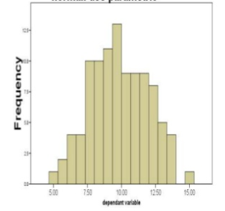
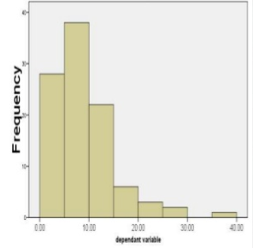
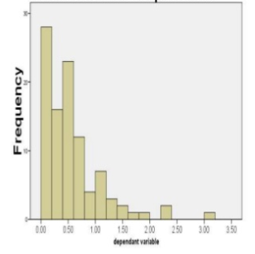
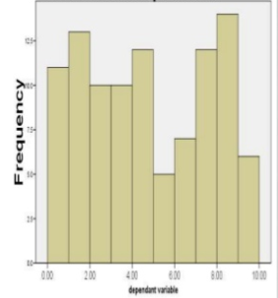
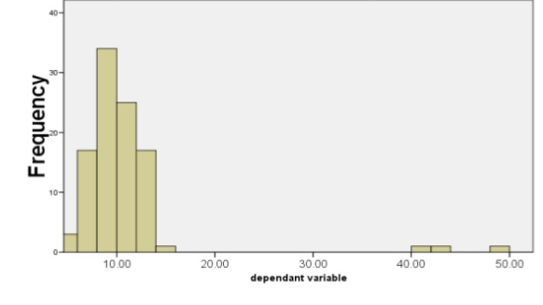
Testing Normality
Normal: Parametric test
Skewed: Non-Parametric test
Skewed: Non-Parametric test
Uniform: Non-Parametric test
Normal + Outliers: Non-Parametric test
Normal
Outliers
https://www.slideshare.net/raghurh/non-parametric-test

Slide 11
Pre-requisite for a test
What is the main study hypothesis?
No hypothesis→ no statistical tests
Hypothesis to be defined prior to the study conduct
Is it confirmatory ?
Is it exploratory?
If multiple hypothesis – are they independent? (p-value reduces with the number of hypothesis)
Are the data independent?
What type of data is being measured?
https://www.healthknowledge.org.uk/public-health-textbook/research-methods/1b-statistical-methods/parametric-nonparametric-tests

Slide 12
Why not just use non-parametric tests?
Non-Parametric tests only test for significance
To estimate parameters or confidence intervals parametric tests are a must
Parametric tests are statistically more powerful and can detect a true difference
Multiple regression or confounding effects cannot be modelled using non-parametric tests

Slide 13
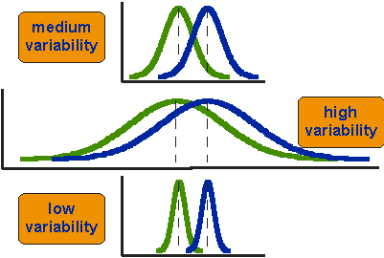
t-test tests: whether the means of two groups are statistically different from each other
T-test
The first thing to notice about the three situations is that the difference between the means is the same in all three
1st case: moderate variability
2nd case: high variability case
3rd case: low variability
Clearly, we would conclude that the two groups appear most different or distinct in the bottom or low-variability case. Why?
Because there is relatively little overlap between the two bell-shaped curves. In the high variability case, the group difference appears least striking because the two bell-shaped distributions overlap so much.
Mean1 Mean2
To find the differences between scores for two groups:
judge the difference between their means relative to the spread or variability of their scores.

Slide 14
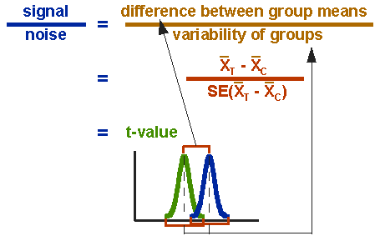

t-test formula
T-test
Signal = the difference between the means is the signal that, in this case, we think our program or treatment introduced into the data;
Noise = a measure of variability that may make it harder to see the group difference
Signal = t-value ➔ 2 groups are different
Noise
One sample t-test
Two sample t-test
Equal sample sizes and equal variance
Unequal sample sizes and equal variance
Unequal sample sizes and unequal variance
Paired t-test

Slide 15
t-test Example: Paired test
T-test
Patient | Before Rx | After Rx | Diff = After - Before
#1 | 130 | 128 | -2
#2 | 102 | 100 | -2
#3 | 154 | 155 | 1
#4 | 113 | 110 | -3
#5 | 139 | 140 | 1
#6 | 125 | 120 | -5
#7 | 156 | 155 | -1
#8 | 108 | 105 | -3
#9 | 161 | 160 | -1
#10 | 105 | 107 | 2
Before Rx and After Rx data for 10 patients, are these measurements same or different ?

Slide 16
t-test Example: 2 sample test
T-test
Patient | Group 1 | Group 2
#1 | 100 | 105
#2 | 86 | 95
#3 | 112 | 120
#4 | 80 | 85
#5 | 115 | 110
#6 | 83 | 100
#7 | 90 | 115
#8 | 94 | 93
#9 | 85 | 107
#10 | 105 | 120
Before Rx and After Rx data for 10 patients, are these measurements same or different ?

Slide 17
Determine Degrees of Freedom
T-test
Degrees of freedom, df, is value indicating the number of independent pieces of information a sample can provide for purposes of statistical inference.
Df = Sample size – Number of parameters estimated
Df for paired t-test is n minus 1

Slide 18
The “F-test”
F-test
Is the difference in the means of the groups more
than background noise (=variability within groups)?
Summarizes the mean differences between all groups at once.
Analogous to pooled variance from a ttest.

Slide 19
The F-distribution
F-test
A ratio of variances follows an F-distribution:
The F-test tests the hypothesis that two variances are equal.
F will be close to 1 if sample variances are equal.

Slide 20
ANOVA example
F-test
Randomize 33 subjects to three groups: 800 mg calcium supplement vs. 1500 mg calcium supplement vs. placebo.
Compare the spine bone density of all 3 groups after 1 year.

Slide 21
F-test
Spine bone density vs. treatment
N=11 = 11 = 11
Mean= 0.92 = 0.94 = 1.06
SD= 0.10 = 0.08 = 0.11
1.2
1.1
Within group variability
Between group variation
1.0
S
P
Within group variability
I
N
E
Within group variability
0.9
0.8
0.7
PLACEBO
800mg CALCIUM
1500 mg CALCIUM

Slide 22
Group means and standard deviations
F-test
Placebo group (n=11):
Mean spine BMD = .92 g/cm²
standard deviation = .10 g/cm²
800 mg calcium supplement group (n=11)
Mean spine BMD = .94 g/cm²
standard deviation = .08 g/cm²
1500 mg calcium supplement group (n=11)
Mean spine BMD =1.06 g/cm²
standard deviation = .11 g/cm²

Slide 23
The F-Test
F-test
The difference of each group’s mean from the overall mean.
Between-group variation.
The size of the groups.
Large F value indicates that the between group variation exceeds the within group variation (=the background noise).
The average amount of variation within groups.
Each group’s variance.

Slide 24
Does learning method affect student’s exam scores?
ANOVA
Consider 3 methods:
standard
osmosis
shock therapy
Convince 15 students to take part. Assign 5 students randomly to each method.
Wait eight weeks. Then, test students to get exam scores.

Slide 25
Suppose … Study #1
ANOVA
Is there a reasonable conclusion?

Slide 26
Suppose … Study #2
ANOVA
Is there a reasonable conclusion?

Slide 27
Suppose … Study #3
ANOVA
Is there a reasonable conclusion?

Slide 28
“Analysis of Variance”
ANOVA
The variation between the group means and the grand mean is larger than the variation within the groups.

Slide 29
“Analysis of Variance”
ANOVA
The variation between the group means and the grand mean is smaller than the variation within the groups.

Slide 30
Analysis of Variance
ANOVA
A division of the overall variability in data values in order to compare means.
Overall (or “total”) variability is divided into two components:
the variability “between” groups, and
the variability “within” groups
Summarized in an “ANOVA” table.

Slide 31
ANOVA Table for Study #1
ANOVA
“F” means “F test statistic”
One-way Analysis of Variance
Source DF SS MS F P
Factor 2 2628.4 1314.2 92.98 0.000
Error 12 169.6 14.1
Total 14 2798
P-Value
“Source” means “the source of the variation in the data”
“DF” means “the degrees of freedom”
“SS” means “the sum of squares”
“MS” means “mean sum of squares”

Slide 32
ANOVA Table for Study #1
ANOVA
One-way Analysis of Variance
Source DF SS MS F P
Factor 2 2628.4 1314.2 92.98 0.000
Error 12 169.6 14.1
Total 14 2798
“Factor” means “Variability between groups” or “Variability due to the factor (or treatment) of interest”
“Error” means “Variability within groups” or “unexplained random error”
“Total” means “Total variation from the grand mean”

Slide 33
ANOVA Notation
ANOVA
Group | Data |  |  |  | Means
1
2
m
 |  | Grand Mean

Slide 34
General ANOVA Table
ANOVA
One-way Analysis of Variance
Source DF SS MS F P
Factor m-1 SS(Between) MSB MSB/MSE
Error n-m SS(Error) MSE
Total n-1 SS(Total)
From F-distribution with m-1 numerator and n-m denominator d.f.
MSB = SS(Between)/(m-1)
MSE = SS(Error)/(n-m)
n-1 = (m-1) + (n-m)
SS(Total) = SS(Between) + SS(Error)

Slide 35
ANOVA Table for Study #1
ANOVA
One-way Analysis of Variance
Source DF SS MS F P
Factor 2 2628.4 1314.2 92.98 0.000
Error 12 169.6 14.1
Total 14 2798
1314.2 = 2628.4/2
14.1 = 169.6/12
14 = 2 + 12
92.98 = 1314.2/14.1
2798 = 2628.4 + 169.6

Slide 36
Total sum of squares SS(TO)
ANOVA
Definition:
Shortcut:

Slide 37
Treatment sum of squares SS(T)
ANOVA
Definition:
Shortcut:

Slide 38
Error sum of squares SS(E)
ANOVA
Definition:
Shortcut:

Slide 39
SS(TO) = SS(T) + SS(E)
ANOVA
We’ve broken down the TOTAL variation into a component due to TREATMENT and a component due to random ERROR.

Slide 40
Recall Study #3
ANOVA

Slide 41
ANOVA Table for Study #3
ANOVA
One-way Analysis of Variance
Source DF SS MS F P
Factor 2 80.1 40.1 0.46 0.643
Error 12 1050.8 87.6
Total 14 1130.9
The P-value is large so we cannot reject the null hypothesis. There is insufficient evidence to conclude that the average exam scores differ for the three learning methods.

Slide 42
Do Holocaust survivors have more sleep problems than others?
ANOVA

Slide 43
ANOVA Table for Sleep Study
ANOVA
One-way Analysis of Variance
Source DF SS MS F P
Factor 2 1723.8 861.9 61.69 0.000
Error 117 1634.8 14.0
Total 119 3358.6

Slide 44
Non-Parametric test
Focuses on Median comparison
Categorizes data
Data are changed from scores to ranks or signs
Analyze these ranked/signed data rather than the actual values
Can be used for testing association
Can be used for testing significance

Slide 45
Commonly used Non-Parametric tests
Chi-Square test
McNemar test
The Sign test
Wilcoxon Sign Ranked test
Mann-Whitney U or Wilcoxon Rank Sum test
The Kruskal Wallis or H test
Friedman Anova
The Spearman Rank correlation test
Cochran’s Q test

Slide 46
Chi-Square test
The Chi-Square test is one of the most commonly used non-parametric test
It offers an alternate method of testing the significance of difference between two proportions
It involves calculation of chi-square; derived from Greek letter “χ”; pronounced as “kye”

Slide 47
Chi-Squared test
Requirements:
Random sample
Categorize qualitative or quantitative data
Lowest expected frequency is not less than 5
There are two types of chi-square tests. Both use the chi-square statistic and distribution for different purposes:
A chi-square goodness of fit test determines if a sample data matches a population.
A chi-square test for independence compares two variables in a contingency table to see if they are related.
It tests to see whether distributions of categorical variables differ from each another.
A very small chi square test statistic means that your observed data fits your expected data extremely well. In other words, there is a relationship.
A very large chi square test statistic means that the data does not fit very well. In other words, there isn’t a relationship.

Slide 48

Chi-Squared test for goodness of fit
The formula for the chi-square statistic used in the chi square test for goodness of fit is:
The subscript “c” are the degrees of freedom. “O” is your observed value and E is your expected value.
A low value for chi-square means there is a high correlation between the two sets of data.
If your observed and expected values were equal (“no difference”) then chi-square would be zero — an event that is unlikely to happen in real life.
The calculated value is called as chi-square statistic; using this statistic and the Degrees of Freedom the p-value is calculated form the chi-square table and then decision on either rejecting or accepting null hypothesis is made.

Slide 49
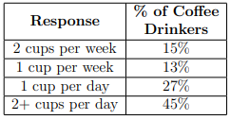
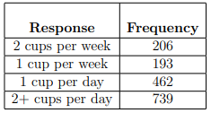
Example:1 – Chi-Square test for Goodness of fit – contd.
Researchers have conducted a survey of 1600 coffee drinkers asking how much coffee they drink in order to confirm previous studies. Previous studies have indicated that 72% of Americans drink coffee.
At α = 0.05, is there enough evidence to conclude that the distributions are the same?
Previous study data
Expected data
Current study data
Observed data
http://websupport1.citytech.cuny.edu/Faculty/mbessonov/MAT1272/Worksheet%20November%2021%20Solutions.pdf

Slide 50
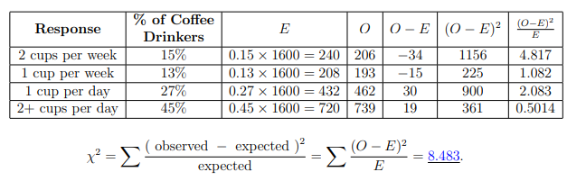
Example:1 – Chi-Square test for Goodness of fit
H₀: The population frequencies are equal to the expected frequencies
H₁: The null hypothesis is false i.e. 72% of Americans drink coffee cannot be confirmed
α = 0.05
The degrees of freedom k-1= 4-1=3
For α = 0.05 and k − 1 = 3, the critical value is 7.815. (find this value from the chi-square table)
Is there enough evidence to reject H₀? Since χ² ≈ 8.483 > 7.815, there is enough statistical evidence to reject the null hypothesis and to believe that the old percentages no longer hold.
http://websupport1.citytech.cuny.edu/Faculty/mbessonov/MAT1272/Worksheet%20November%2021%20Solutions.pdf

Slide 51

Example:2 – Chi-Square test for Goodness of fit – contd.
A department store, A, has four competitors: B,C,D, and E.
Store A hires a consultant to determine if the percentage of shoppers who prefer each of the five stores is the same.
A survey of 1100 randomly selected shoppers is conducted, and the results about which one of the stores shoppers prefer are below.
Is there enough evidence using a significance level α = 0.05 to conclude that the proportions are really the same?
http://websupport1.citytech.cuny.edu/Faculty/mbessonov/MAT1272/Worksheet%20November%2021%20Solutions.pdf

Slide 52
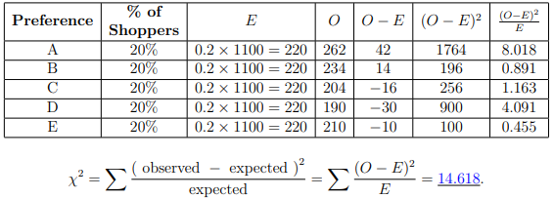
Example:2 – Chi-Square test for Goodness of fit
H₀: The population frequencies are equal to the expected frequencies
H₁: The null hypothesis is false
α = 0.05
The degrees of freedom k-1= 5-1=4
For α = 0.05 and k − 1 = 4, the critical value is 9.488. (find this value from the chi-square table)
Is there enough evidence to reject H₀? Since χ² ≈ 14.618 > 9.488, there is enough statistical evidence to reject the null hypothesis and to believe that the old percentages no longer hold.
http://websupport1.citytech.cuny.edu/Faculty/mbessonov/MAT1272/Worksheet%20November%2021%20Solutions.pdf

Slide 53

Chi-Squared test for Independence
A chi-square independence test is used to test whether or not two variables are independent
To use the test, the same assumptions must be satisfied: the observed frequencies are obtained through a simple random sample, and each expected frequency is at least 5
The frequencies are written down in a table: the columns contain outcomes for one variable, and the rows contain outcomes for the other variable
The expected frequency E_{r,c} for the entry in row r, column c is calculated using:
The degrees of freedom: (number of rows - 1)×(number of columns - 1)
http://websupport1.citytech.cuny.edu/Faculty/mbessonov/MAT1272/Worksheet%20November%2021%20Solutions.pdf

Slide 54

Example:1 – Chi-Square test for Independence – contd.
The side effects of a new drug are being tested against a placebo.
A simple random sample of 565 patients yields the results below.
At a significance level of α = 0.1, is there enough evidence to conclude that the treatment is independent of the side effect of nausea?
Data Observed
http://websupport1.citytech.cuny.edu/Faculty/mbessonov/MAT1272/Worksheet%20November%2021%20Solutions.pdf

Slide 55
Example:1 – Chi-Square test for Independence
H₀: The treatment and response are independent
H₁: The treatment and response are dependent
α = 0.1
(number of rows - 1)×(number of columns - 1) =
(2 − 1) × (2 − 1) = 1 × 1 = 1
Expected Data
Result | Drug (c.1) | Placebo (c.2) | Total
Nausea (r.1) | 49*290/565= 25.15 | 49*275/565= 23.85 | 49
No Nausea (r.2) | 516*290/565= 264.85 | 516*275/565= 251.15 | 516
Total | 290 | 275 | 565
http://websupport1.citytech.cuny.edu/Faculty/mbessonov/MAT1272/Worksheet%20November%2021%20Solutions.pdf

Slide 56
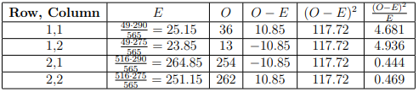

Example:1 – Chi-Square test for Independence
The test statistic:
From α = 0.1 and d.f = 1, the critical value is 2.706.
Is there enough evidence to reject H₀? Since χ² ≈ 10.53 > 2.706, there is enough statistical evidence to reject the null hypothesis and to believe that there is a relationship between the treatment and response.
http://websupport1.citytech.cuny.edu/Faculty/mbessonov/MAT1272/Worksheet%20November%2021%20Solutions.pdf

Slide 57
Example:2 – Chi-Square test for Independence – contd.
The results of a random sample of children with pain from musculoskeletal injuries treated with acetaminophen, ibuprofen, or codeine are shown in the table.
At α = 0.1, is there enough evidence to conclude that the treatment and result are independent?
Data Observed
 | Acetaminophen (c. 1) | Ibuprofen (c. 2) | Codeine (c. 3) | Total
(r. 1) Significant Improvement | 58 | 81 | 61 | 200
(r. 2) Slight Improvement | 42 | 19 | 39 | 100
Total | 100 | 100 | 100 | 300
http://websupport1.citytech.cuny.edu/Faculty/mbessonov/MAT1272/Worksheet%20November%2021%20Solutions.pdf

Slide 58
Example:1 – Chi-Square test for Independence
H₀: The treatment and response are independent
H₁: The treatment and response are dependent
α = 0.1
(number of rows - 1)×(number of columns - 1) =
(2 − 1) × (3 − 1) = 1 × 2 = 2
Expected Data
 | Acetaminophen (c. 1) | Ibuprofen (c. 2) | Codeine (c. 3) | Total
(r. 1) Significant Improvement | 200*100/300 = 66.67 | 200*100/300 = 66.67 | 200*100/300 = 66.67 | 200
(r. 2) Slight Improvement | 100*100/300 = 33.33 | 100*100/300 = 33.33 | 100*100/300 = 33.33 | 100
Total | 100 | 100 | 100 | 300
http://websupport1.citytech.cuny.edu/Faculty/mbessonov/MAT1272/Worksheet%20November%2021%20Solutions.pdf

Slide 59
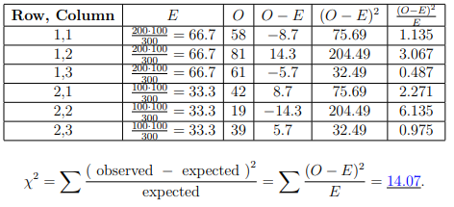
Example:1 – Chi-Square test for Independence
The test statistic:
From α = 0.10 and d.f = 2, the critical value is 4.605.
Is there enough evidence to reject H₀? Since χ² ≈ 14.07 > 4.605, there is enough statistical evidence to reject the null hypothesis and to believe that there is a relationship between the treatment and response.
http://websupport1.citytech.cuny.edu/Faculty/mbessonov/MAT1272/Worksheet%20November%2021%20Solutions.pdf

Slide 60
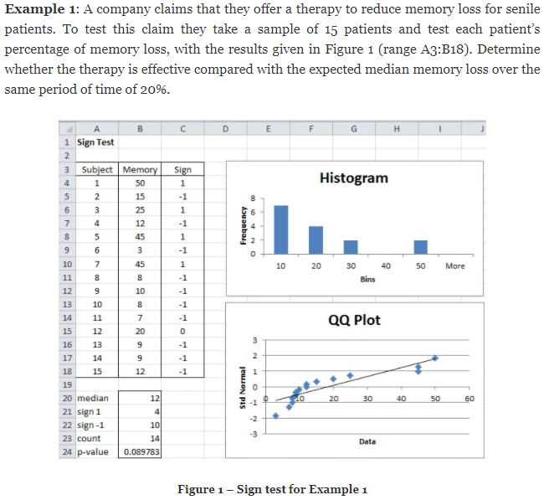
Sign test (1/2)
Similar to single sample t-test
References for QQ plot
Link
http://www.real-statistics.com/non-parametric-tests/sign-test/

Slide 61
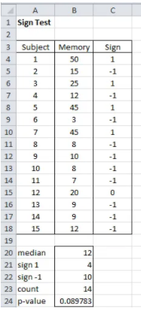
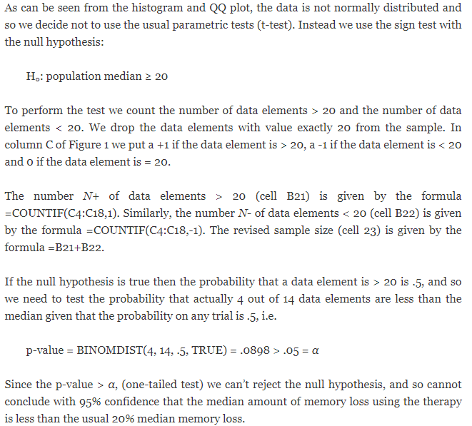
Sign test (2/2)
http://www.real-statistics.com/non-parametric-tests/sign-test/

Slide 62
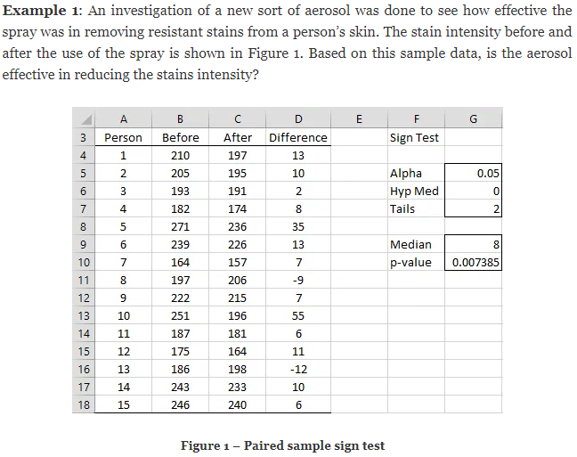
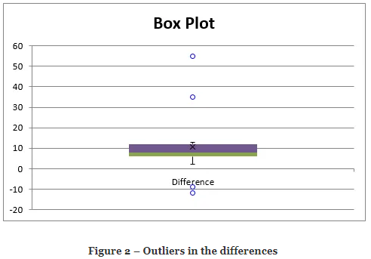

Paired Sample Sign test
Similar to paired t-test
http://www.real-statistics.com/non-parametric-tests/sign-test/paired-sample-sign-test/

Slide 63
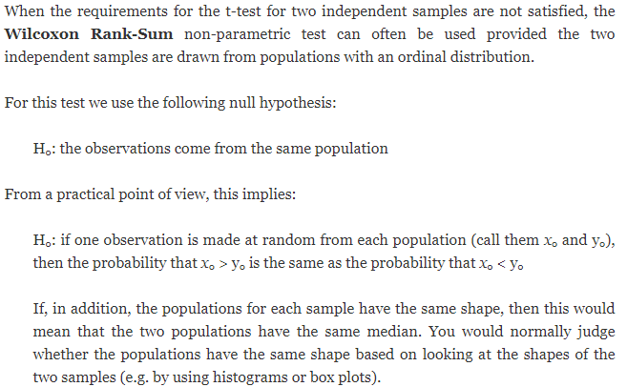
Wilcoxon Rank Sum Test for Independent Samples (1/4)
Similar to t-test for 2 independent samples
http://www.real-statistics.com/non-parametric-tests/wilcoxon-rank-sum-test/

Slide 64
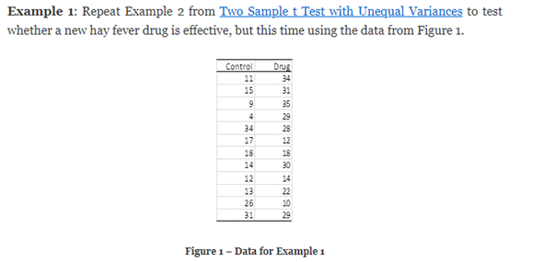
Wilcoxon Rank Sum Test for Independent Samples (2/4)
Similar to t-test for 2 independent samples
http://www.real-statistics.com/non-parametric-tests/wilcoxon-rank-sum-test/

Slide 65
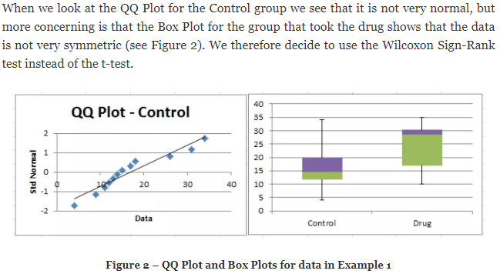
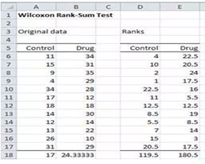
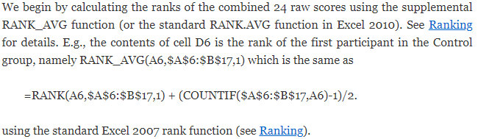
Wilcoxon Rank Sum Test for Independent Samples (3/4)
Similar to t-test for 2 independent samples
http://www.real-statistics.com/non-parametric-tests/wilcoxon-rank-sum-test/

Slide 66
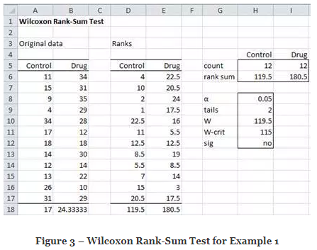
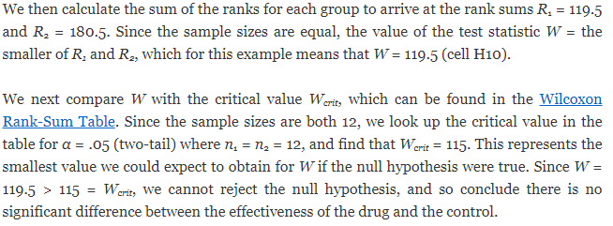
Wilcoxon Rank Sum Test for Independent Samples (4/4)
Similar to t-test for 2 independent samples
http://www.real-statistics.com/non-parametric-tests/wilcoxon-rank-sum-test/

Slide 67
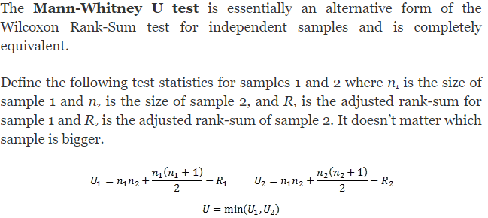
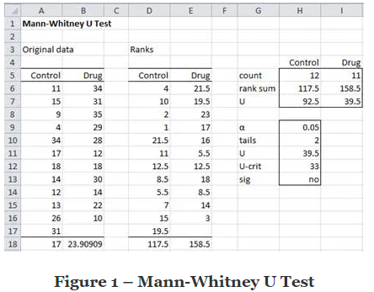

Mann-Whitney U test (1/2)
Similar to t-test for 2 independent samples
Data from the earlier example with one value dropped for Drug
http://www.real-statistics.com/non-parametric-tests/mann-whitney-test/

Slide 68
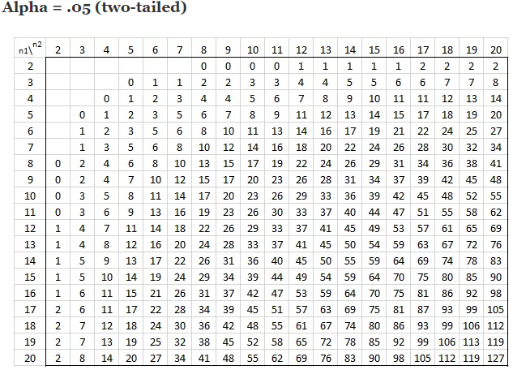
Mann-Whitney U test (2/2)
Similar to t-test for 2 independent samples
Mann-Whitney table
n1 = 12,
n2 = 11
http://www.real-statistics.com/statistics-tables/mann-whitney-table/

Slide 69
Flow chart for statistical testing
http://abacus.bates.edu/~ganderso/biology/resources/stats_flow_chart_v2003.pdf
https://www.isixsigma.com/community/blogs/the-history-of-the-hypothesis-testing-flow-chart/

